Slide 1
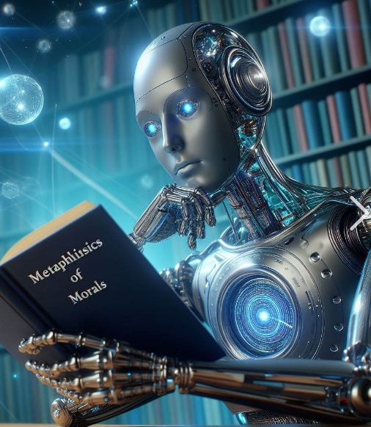
NLP
Natural Language Processing
Notes:
Metaphysics of Morals - Wikipedia

Slide 2
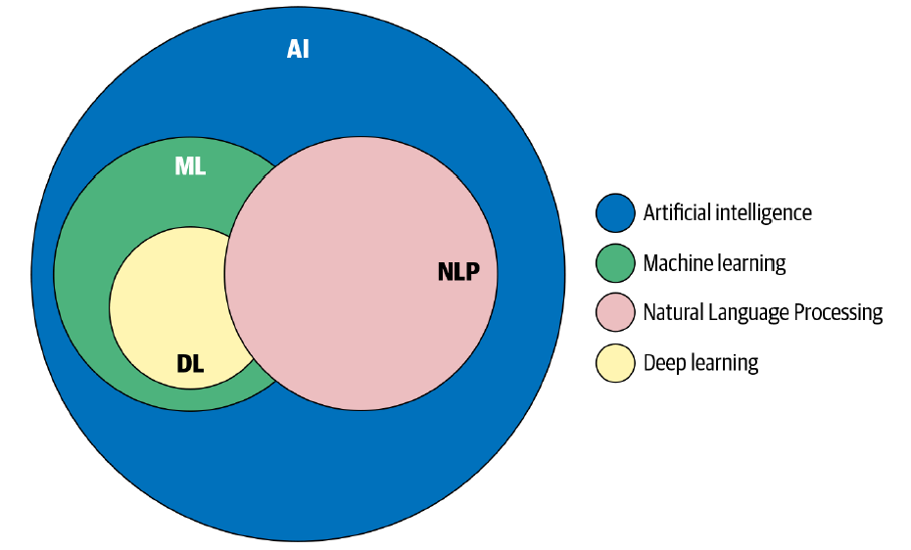

Slide 3
NLP Tasks
Sentiment Analysis: Determines the emotional intent of text, such as identifying whether a review is positive or negative
Speech Recognition (Speech-to-Text): Converts spoken language into written text
Text Classification: Assigns predefined labels or categories to text data (e.g., spam detection, topic categorization)
Named Entity Recognition (NER): Identifies and extracts entities (e.g., names of people, organizations, locations) from text
Part-of-Speech Tagging: Labels each word in a sentence with its grammatical role (, noun, verb, adjective)
Language Translation: Translates text from one language to another
Text Summarization: Generates concise summaries of longer texts
Question Answering: Extracts relevant information from a given text to answer user queries
Text Generation: Creates new text based on patterns learned from existing data (e.g., chatbots, language models)
Information Retrieval: Retrieves relevant documents or passages based on user queries
Named Entity Linking: Connects named entities to external knowledge bases (e.g., linking a person’s name to their Wikipedia page)

Slide 4

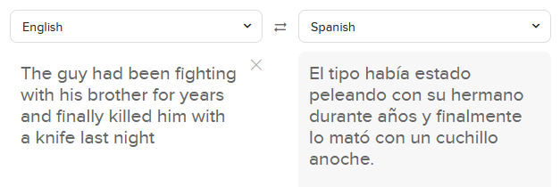
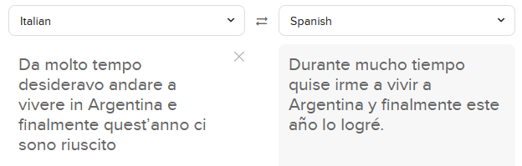

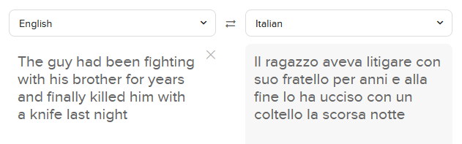
Language Translation

Slide 5
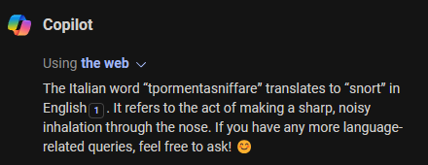
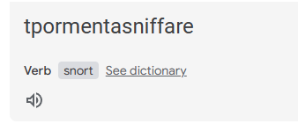
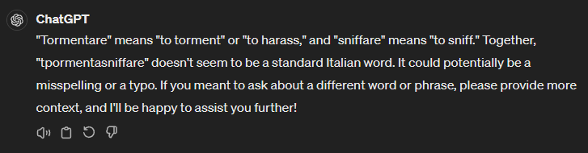
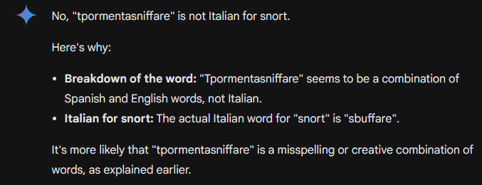
Language Translation
Notes:
Copilot and Google Translate think it is Italian, ChatGPT and Google Gemini think not

Slide 6
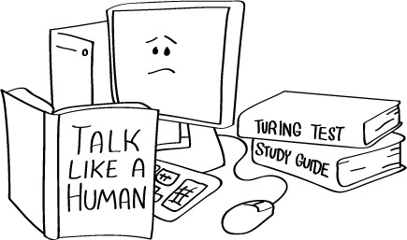

Slide 7
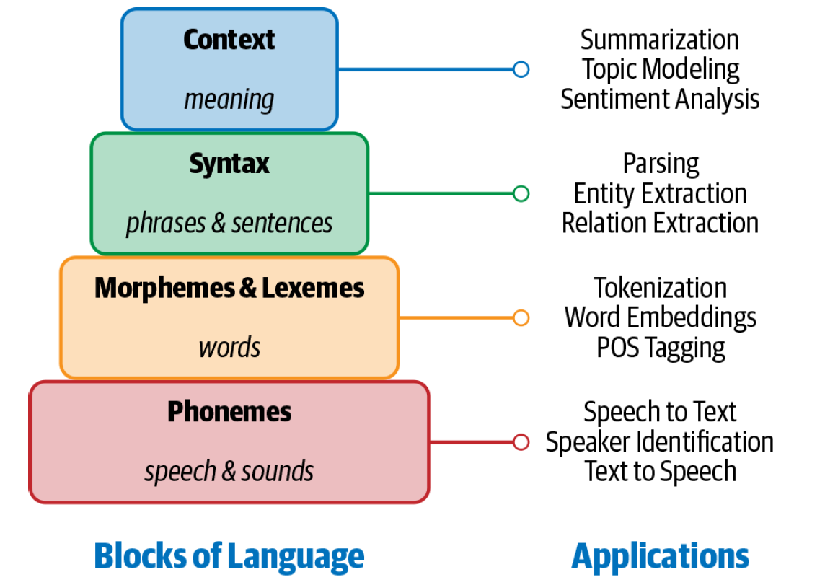
Language Components

Slide 8
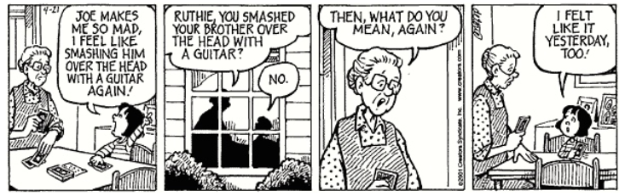
Why NLP is difficult
The ambiguity of the language
Here we see examples of ambiguity
It relies on contextual information
Implicit references, implicit memory, colloquialism
Machine cannot understand creativity (poems, etc…)
There is no direct mapping between the vocabularies of any two languages

Slide 9
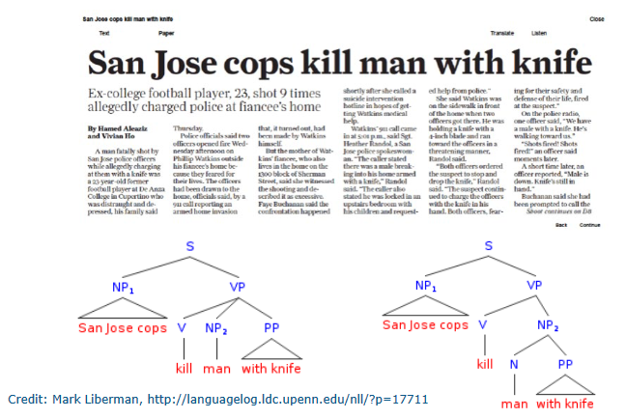
Why NLP is difficult
The ambiguity of the language
Here we see examples of ambiguity
It relies on contextual information
Implicit references, implicit memory, colloquialism
Machine cannot understand creativity (poems, etc…)
There is no direct mapping between the vocabularies of any two languages

Slide 10
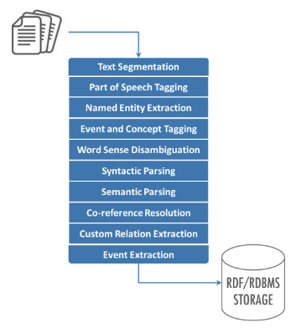
Classic NLP Pipeline

Slide 11
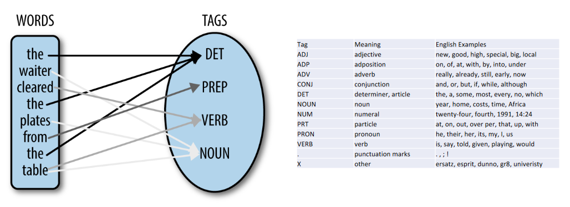
Classic NLP Pipeline
Part of Speech Tagging

Slide 12
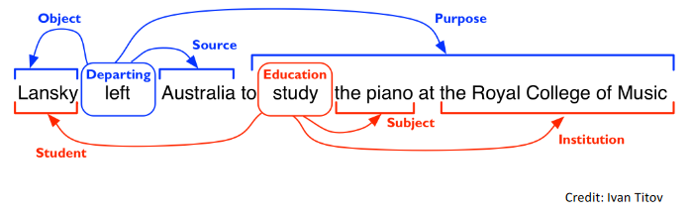
Classic NLP Pipeline
Semantic Parsing

Slide 13
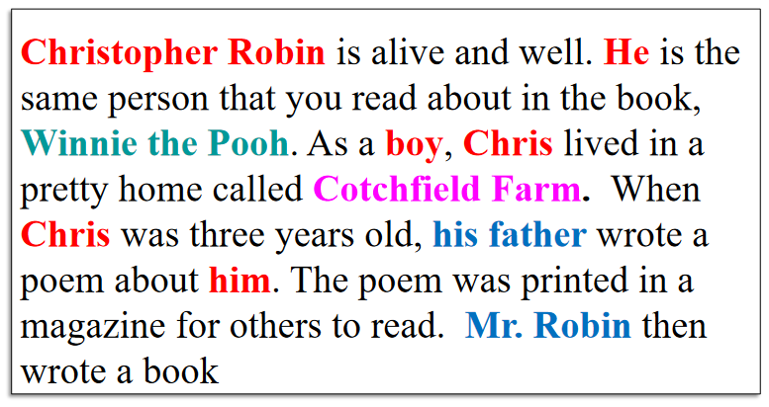
Classic NLP Pipeline
Co-reference Resolution

Slide 14
Machine Learning for NLP
Better to use Deep Learning!
Recurrent Neural Networks (RNNs)
Transformers

Slide 15
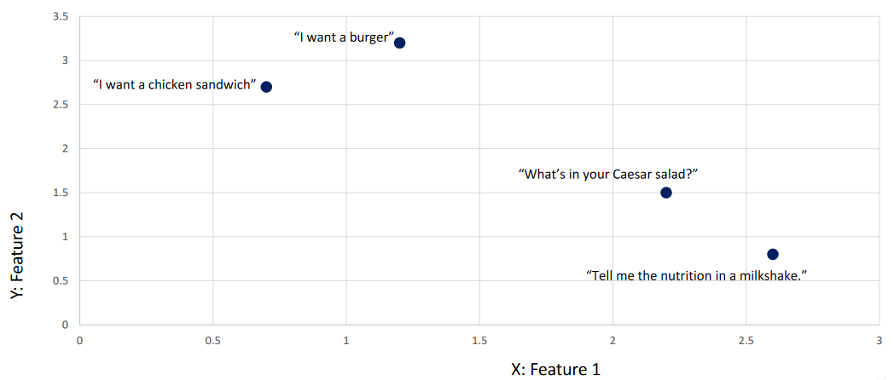
Machine Learning for NLP
INFORMATION ABOUT FOOD - CLASS
ORDERING FOOD - CLASS

Slide 16
Machine Learning for NLP
INFORMATION ABOUT FOOD - CLASS
ORDERING FOOD - CLASS
Which features should we use to achieve this type of classification?
It is difficult…

Slide 17
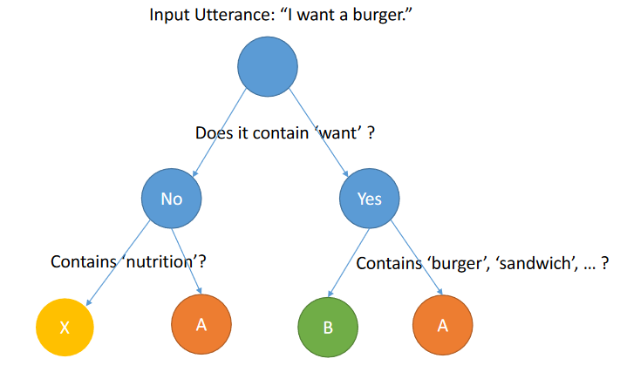
Machine Learning for NLP
Let’s try with a decision tree…
…but too many complex interactions exist

Slide 18
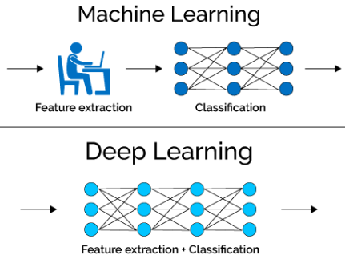
Machine Learning for NLP
We can use Deep Learning
It will learn the best features on its own
Deep neural networks perform better, but are less explainable
Decision trees, linear models are all far easier to explain, but lack expressive power

Slide 19
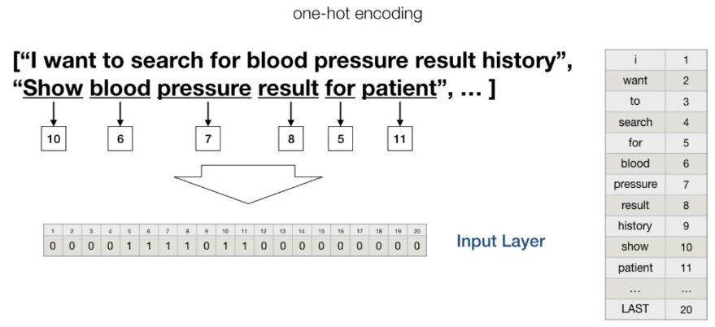
Deep Neural Networks for NLP
Natural language is made up of letters
We need to represent natural language in some vector space

Slide 20
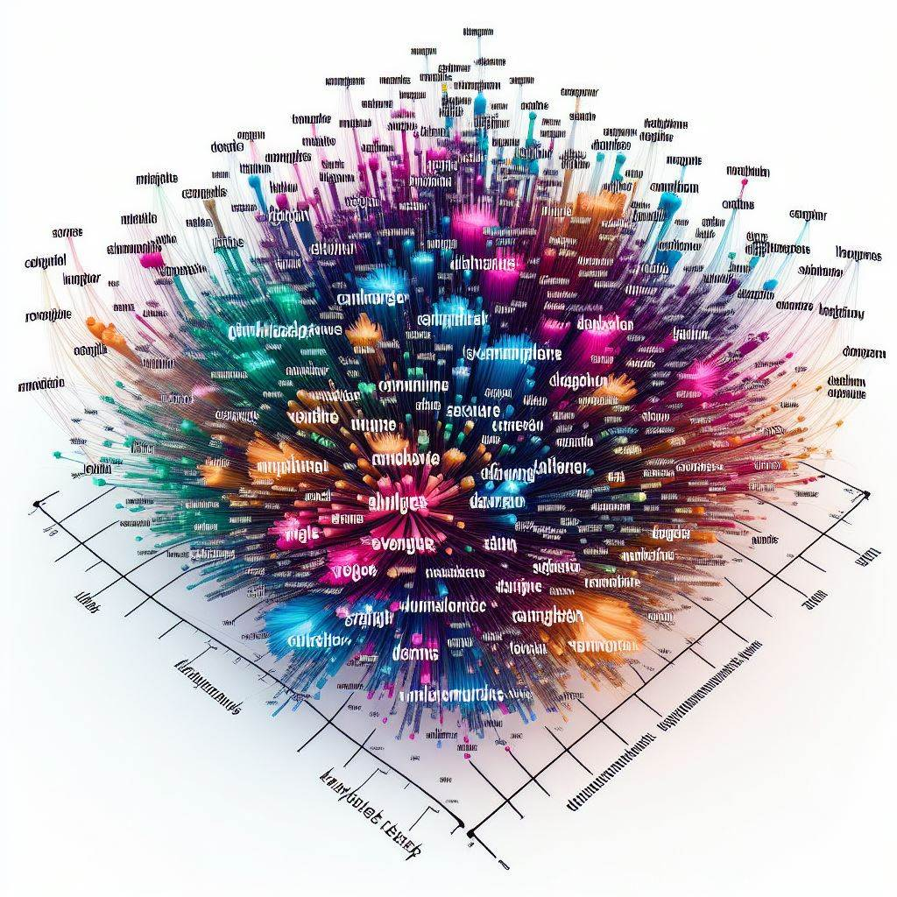
Word Embedding

Slide 21
Word Embedding
Word Embedding makes words into vectors so to be understandable by machines
Solution A: One-Hot vectors
“Milo is a cat”
“A cat eats fish”
“Milo eats fish”
We have 6 unique words, the length of the vectors of the One-Hot Encoding is 6
We can create the vectors by order of apparition
Milo (1, 0, 0, 0, 0, 0)
is (0, 1, 0, 0, 0, 0)
a (0, 0, 1, 0, 0, 0)
cat (0, 0, 0, 1, 0, 0)
eats (0, 0, 0, 0, 1, 0)
fish (0, 0, 0, 0, 0, 1)

Slide 22
Word Embedding
Word Embedding makes words into vectors so to be understandable by machines.
Solution A: One-Hot vectors
“Milo is a cat” (1,1,1,1,0,0)
“A cat eats fish” (0,0,1,1,1,1)
“Milo eats fish” (1,0,0,0,1,1)
“A fish eats cat” (0,0,1,1,1,1)
These are the sentences converted using this one-hot encoding
Milo (1, 0, 0, 0, 0, 0)
is (0, 1, 0, 0, 0, 0)
a (0, 0, 1, 0, 0, 0)
cat (0, 0, 0, 1, 0, 0)
eats (0, 0, 0, 0, 1, 0)
fish (0, 0, 0, 0, 0, 1)

Slide 23
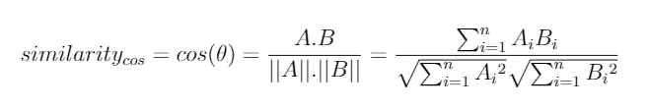
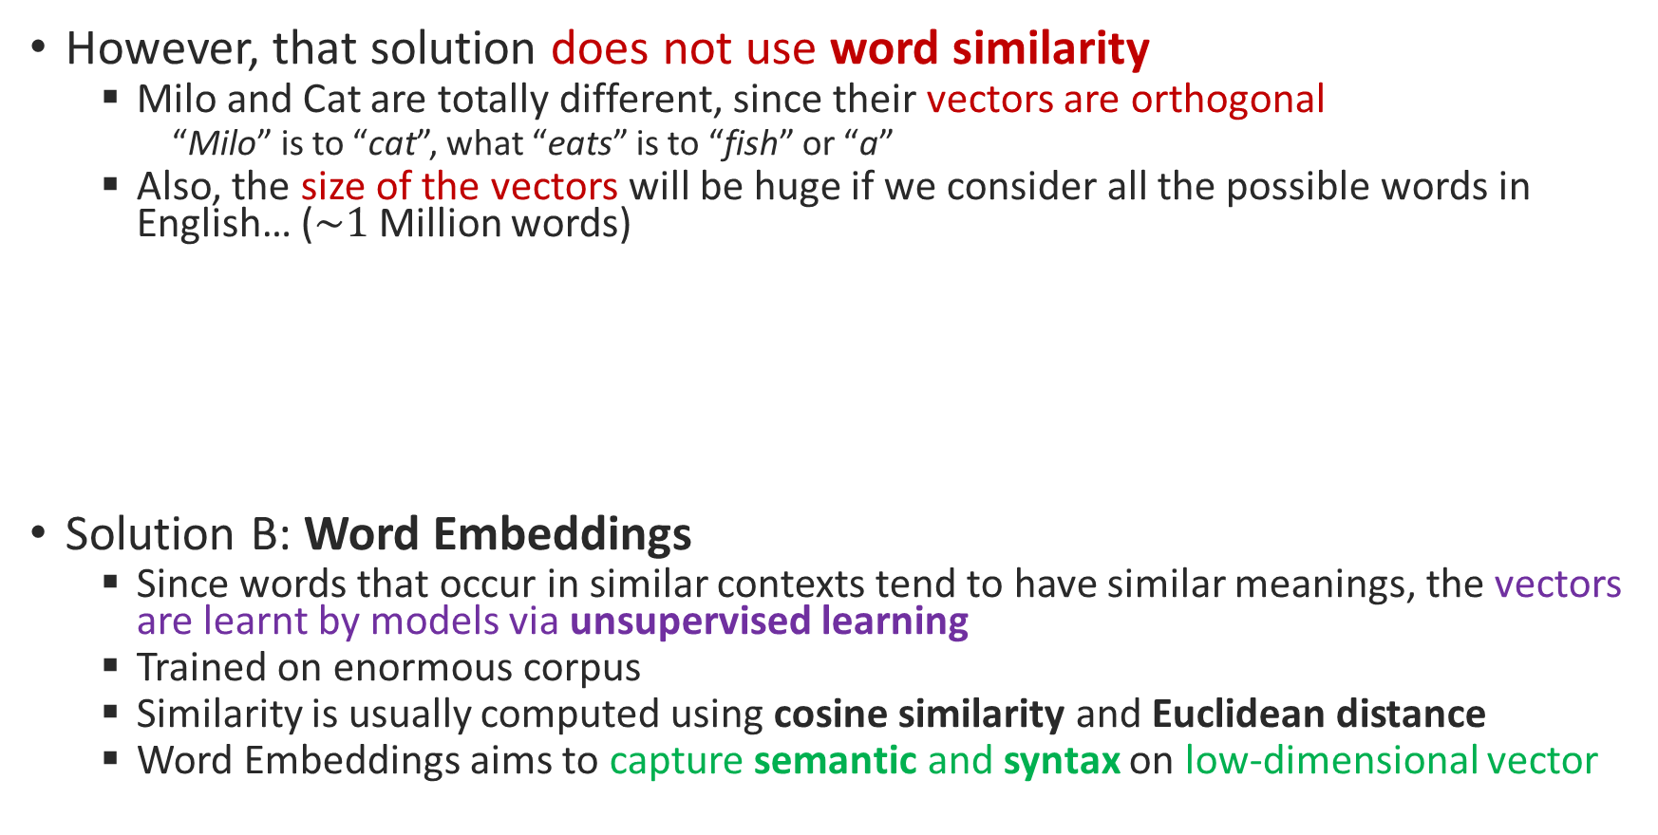
Word Embedding
However, that solution does not use word similarity
Milo and Cat are totally different, since their vectors are orthogonal
“Milo” is to “cat”, what “eats” is to “fish” or “a”
Also, the size of the vectors will be huge if we consider all the possible words in English… ($\sim 1$Million words)
Solution B: Word Embeddings
Since words that occur in similar contexts tend to have similar meanings, the vectors are learnt by models via unsupervised learning
Trained on enormous corpus
Similarity is usually computed using cosine similarity and Euclidean distance
Word Embeddings aims to capture semantic and syntax on low-dimensional vector

Slide 24
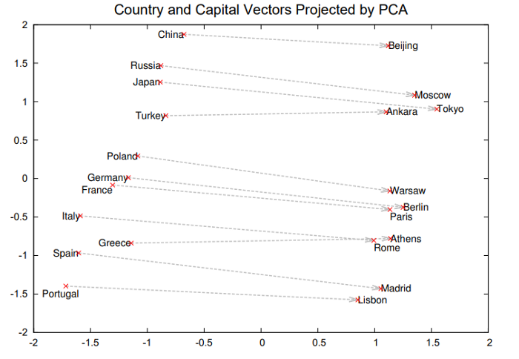
Word Embedding
Source: “Distributed Representations of Words and Phrases and their Compositionality”, 2013
Notes:
https://arxiv.org/abs/1310.4546

Slide 25
Word Embedding… before
Words were encoded through statistics
SVD (Singular Value Decomposition)
A dimensionality reduction on a co-occurrence matrix
SVD is then used to process LSI (Latent Semantic Indexing)
LSI allows term to term similarity, document to document similarity, and term to document similarity
SVD is based on matrix decomposition, so the dimensions of the matrix change when the dictionary change
The whole decomposition must be re-calculated when we add a new word!
It is also very sensitive to word frequency imbalance
It is not suitable for large dictionaries or corpora, too expensive

Slide 26
Word Embedding using Word2Vec (Mikolov et al., 2013)
First models were based on Feed-Forward architecture, Recurrent Neural Network (RNN), but they had a too high training complexity
Word2Vec introduces simplicity (1000x faster training!) by reducing the # of hidden layers (present in the above architectures)
Efficient training!

Slide 27
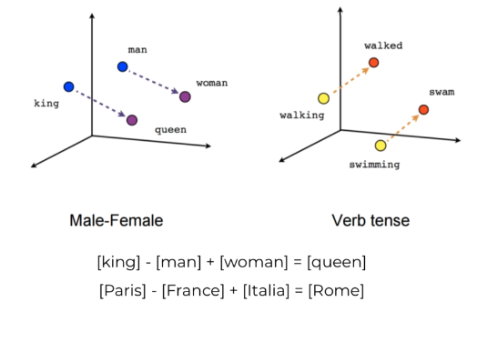
Word2Vec
A word embedding is a way of mapping words to vectors
Word2vec: unsupervised method based on corpus statistics
Built-in embedding layers: tensorflow/keras support “Embedding layers”

Slide 28
Word2Vec
Related words should be “Close” in a Euclidean sense, Unrelated words should be far away
“cloud” – “sky” < “cloud” – “steak”
Notes:
Inequality with words

Slide 29
Word2Vec
Arithmetic should be possible:

Slide 30
Word2Vec
How large the vector should be?
What if we have, say, 50 elements in the vector for each word with values between, say, -1.6 and 1.6?
This is a dense vector.
In this way, the vector defines points in space
If well done, the closer points will correspond to closer meaning
50 is the minimum, 300 is more realistic, but also 1000, or 2000, or more but still much smaller than a 500.000 elements vector for One-hot…

Slide 31
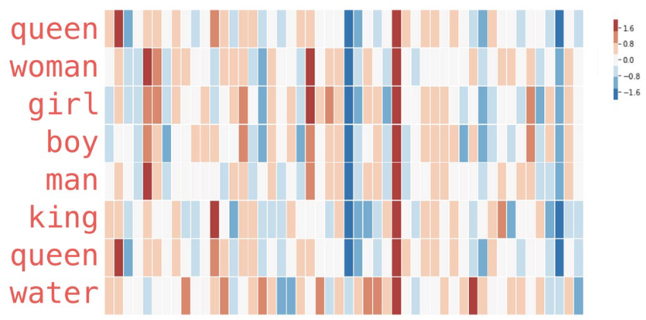
Word2Vec
Let’s see the word embedding of these words:

Slide 32
Word2Vec – How does it work?
In input we have text (corpus), and in output we have a vectorized representation of the words in the text.
This: [0.240, 0.145, 0.062, … ]
is: [0.412, 0.011, 0.177, … ]
a: [0.105, 0.035, 0.094, … ]
…
Word2Vec
This is a very large corpus of words

Slide 33
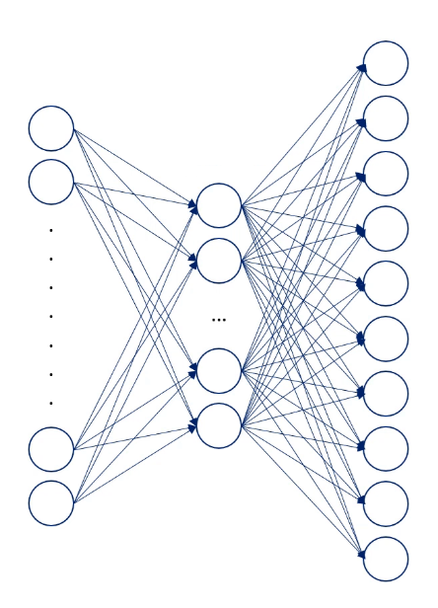
Input Layer:
This one-hot vector represents one of the words in our vocabulary:
Output Layer:
Probability of every word in the vocabulary to appear in proximity of the input word:
Softmax
0.000.. for word “A”
0.000.. for word “Aardvark”
0
0
0
1
0
0
0
…
0.000.. for word “Aback”
0.000.. for word “Abacus”
Word input
0.000.. for word “Abaft”
0.000.. for word “Abandon”
0.000.. for word “Abandoned”
0.000.. for word “Abandoning”
0.000.. for word “Abandonment”
0.000.. for word “Abandons”
…

Slide 34
Softmax
Hidden Layer:
How many weights in the hidden layer?
If we have 10,000 words and we select the number of features to be 300 (hyperparameter), then:
10,000 x 300
When you input the one-hot vector, only the weights corresponding to that specific word will not be 0
0
0
0
1
0
0
0
…
Word input
Notes:
10000 x 300 is the size of the Google example when they introduced Word2Vec, but could and usually is more

Slide 35
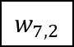
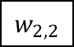
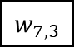
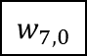
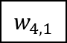
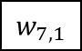
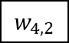
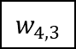
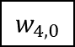
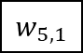
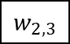
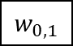
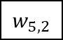
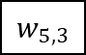
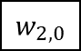
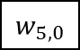
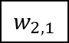
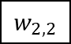

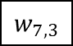

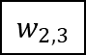

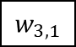
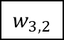







































Input Layer:
One-hot vector representing a word from the vocabulary
Weight Matrix (input –> hidden)
10,000 x 300
Weight Matrix (hidden –> output)
300 x 10,000
Hidden Layer’s Nodes
$$w_{0,0}$$
$$w_{0,1}$$
$$w_{0,2}$$
$$w_{0,3}$$
$$w_{0,0}$$
$$w_{0,1}$$
$$w_{0,2}$$
$$w_{0,3}$$
$$w_{1,0}$$
$$w_{1,1}$$
$$w_{1,2}$$
$$w_{1,3}$$
$$w_{1,0}$$
$$w_{1,1}$$
$$w_{1,2}$$
$$w_{1,3}$$
0
0
0
1
0
0
0
…
$$w_{2,0}$$
$$w_{2,1}$$
$$w_{2,2}$$
$$w_{2,3}$$
$$w_{2,0}$$
$$w_{2,1}$$
$$w_{2,2}$$
$$w_{2,3}$$
$$w_{3,0}$$
$$w_{3,1}$$
$$w_{3,2}$$
$$w_{3,3}$$
…
$$w_{3,0}$$
$$w_{3,1}$$
$$w_{3,2}$$
$$w_{3,3}$$
$$w_{4,0}$$
$$w_{4,1}$$
$$w_{4,2}$$
$$w_{4,3}$$
$$w_{4,0}$$
$$w_{4,1}$$
$$w_{4,2}$$
$$w_{4,3}$$
$$w_{5,0}$$
$$w_{5,1}$$
$$w_{5,2}$$
$$w_{5,3}$$
$$w_{5,0}$$
$$w_{5,1}$$
$$w_{5,2}$$
$$w_{5,3}$$
$$w_{6,0}$$
$$w_{6,1}$$
$$w_{6,2}$$
$$w_{6,3}$$
$$w_{6,0}$$
$$w_{6,1}$$
$$w_{6,2}$$
$$w_{6,3}$$
$$w_{7,0}$$
$$w_{7,1}$$
$$w_{7,2}$$
$$w_{7,3}$$
$$w_{7,0}$$
$$w_{7,1}$$
$$w_{7,2}$$
$$w_{7,3}$$
…
…
…
…
…
…
…
…
…
There are 10,000 rows
(one per word)
And 300 columns
(one per feature)
There are 300 rows
(one per feature)
And 10,000 columns
(one per word)
Notes:
10000 x 300 is the size of the Google example when they introduced Word2Vec, but could and usually is more

Slide 36




Input Layer:
One-hot vector representing a word from the vocabulary
Weight Matrix (input –> hidden)
10,000 x 300
Weight Matrix (hidden –> output)
300 x 10,000
Hidden Layer’s Nodes
-0.3
$$w_{0,0}$$
$$w_{0,1}$$
$$w_{0,2}$$
$$w_{0,3}$$
$$w_{1,0}$$
$$w_{1,1}$$
$$w_{1,2}$$
$$w_{1,3}$$
0
0
0
1
0
0
0
…
-0.7
$$w_{2,0}$$
$$w_{2,1}$$
$$w_{2,2}$$
$$w_{2,3}$$
0.1
$$w_{3,0}$$
$$w_{3,2}$$
$$−0.3$$
$$0.7$$
$$0.1$$
$$−0.8$$
…
$$w_{3,1}$$
$$w_{3,3}$$
…
-0.8
$$w_{4,0}$$
$$w_{4,1}$$
$$w_{4,2}$$
$$w_{4,3}$$
$$w_{5,0}$$
$$w_{5,1}$$
$$w_{5,2}$$
$$w_{5,3}$$
…
$$w_{6,0}$$
$$w_{6,1}$$
$$w_{6,2}$$
$$w_{6,3}$$
$$w_{7,0}$$
$$w_{7,1}$$
$$w_{7,2}$$
$$w_{7,3}$$
…
…
…
…
…
…
…
…
The hidden layer’s nodes contain the same value as the “selected” row in the previous weight matrix
Notes:
10000 x 300 is the size of the Google example when they introduced Word2Vec, but could and usually is more

Slide 37
































Weight Matrix (hidden –> output)
300 x 10,000
Hidden Layer’s Nodes
Output Layer’s Nodes
-0.3
$$w_{0,0}$$
$$w_{0,1}$$
$$w_{0,2}$$
$$w_{0,3}$$
Target Vector:
This is used to tune the loss function
$$w_{1,0}$$
$$w_{1,1}$$
$$w_{1,2}$$
$$w_{1,3}$$
0
0
0
0
0
0
1
…
-0.7
$$w_{2,0}$$
$$w_{2,1}$$
$$w_{2,2}$$
$$w_{2,3}$$
0.1
$$w_{3,0}$$
$$w_{3,2}$$
…
$$w_{3,1}$$
$$w_{3,3}$$
…
-0.8
$$w_{4,0}$$
$$w_{4,1}$$
$$w_{4,2}$$
$$w_{4,3}$$
$$w_{5,0}$$
$$w_{5,1}$$
$$w_{5,2}$$
$$w_{5,3}$$
…
$$w_{6,0}$$
$$w_{6,1}$$
$$w_{6,2}$$
$$w_{6,3}$$
Note that, by “studying” the corpus, we know which probability to expect for every input-target pair of words
$$w_{7,0}$$
$$w_{7,1}$$
$$w_{7,2}$$
$$w_{7,3}$$
…
…
…
…
…
The output layer contains the probability of every word in the vocabulary to appear in proximity of the input word
Notes:
10000 x 300 is the size of the Google example when they introduced Word2Vec, but could and usually is more

Slide 38


“You shall know a word by the company it keeps” – J.R. Firth, 1957
Two versions of Word2Vec (both containing only one hidden layer)
Continuous Bag-of-words (CBOW)
Predicts the central word based on a window of words surrounding it
Skip-Gram (SG)
Predicts the context (surrounding words) based on the central word (opposite of CBOW)
CBOW Objective Function
SG Objective Function
Notes:
Wittgenstein said something similar: “…the meaning of a word is its use in the language.”

Slide 39

Continuous Bag-of-words (CBOW)
The log likelihood of a sequence of words is:
$$\log{P\left(w\right)=\sum_{t=1}^{T}{\log{P\left(w_{t−m:t+m}\right)=\sum_{t=1}^{T}{log\frac{exp⁡(v_{w^{t}}^{T}{\overline{v}}_{t})}{\sum_{W^{′}}{exp⁡(v_{w^{′}}^{T}{\overline{v}}_{t})}}}}}}$$
$v_{w_{t}}$ is the vector of the word at location $w_{t}$
$V$ is the set of all words
$m$ is the context size
${\overline{v}}_{t}=\frac{1}{2m}\sum_{h=1}^{m}{{(v}_{w_{t+h}}+{ v}_{w_{t−h}}})$ is the average of the word vectors around $w_{t}$
Softmax
We try to predict each word given its context
Notes:
${\overline{v}}_{t}$is the average of the word vectors in the window around $w_{t}$
Divided by 2m to normalize (-m and +m words)
Note that we removed the – in front, that is added to minimize the Loss(log) or Loss(J($θ))$, but here we want to maximize the likelihood given the vectors

Slide 40



Continuous Bag-of-words (CBOW)
The log likelihood of a sequence of words is:
$$\log{P\left(w\right)=\sum_{t=1}^{T}{\log{P\left(w_{t−m:t+m}\right)=\sum_{t=1}^{T}{log\frac{exp⁡(v_{w^{t}}^{T}{\overline{v}}_{t})}{\sum_{W^{′}}{exp⁡(v_{w^{′}}^{T}{\overline{v}}_{t})}}}}}}$$
“The moon whispered secrets to the night, and the stars listened intently”
$$\log{P\left(\text{"}\text{The} \text{moon}\text{…}\text{intently}\text{"}\right)=}$$
$$\log{P\left(\text{“}\text{The} \text{moon} \text{whispered}\text{” }\right)+}$$
$$\log{P\left(\text{“}\text{The} \text{moon} \text{whispered} \text{secrets}\text{” }\right)+}$$
$$\log{P\left(\text{“}\text{The} \text{moon} \text{whispered} \text{secrets} \text{to}\text{” }\right)+}$$
$$\log{P\left(\text{“}\text{moon} \text{whispered} \text{secrets} \text{to} \text{the}\text{” }\right)+}$$
…
$$m=2$$
Notes:
${\overline{v}}_{t}$is the average of the word vectors in the window around $w_{t}$

Slide 41

Word2Vec
Continuous bag-of-words (CBOW)
Continuous skip-gram
In CBOW the order of surrounding words does NOT matter
In Skip-gram, it does matter: closer words are weighted more
CBOW is faster while skip-gram does a better job for infrequent words

Slide 42


SG Objective Function
$$L\left(θ\right)= \prod_{t=1}^{T}{\prod_{−n≤j≤n}{P(w_{t+j}|w_{t};θ)}}$$
$θ$ is all the variables to optimize, in our case it is simply the vector representation of the words (well, actually there are two vectors…see next slides)
$L(θ)$ is the likelihood
The higher is $L(θ)$ the better our model can predict the words given the center word
$n$ is the windows size (left and right of the center word)
Notes:
The probability will be between 0 and 1, so the log will be negative. Also, the higher is the probability the closer it will be the 1, so to 0 after computing the log. In other words, the higher is the probability (the model guesses “more correctly”) the lower is the loss.

Slide 43

SG Objective Function
$$L\left(θ\right)= \prod_{t=1}^{T}{\prod_{−n≤j≤n}{P(w_{t+j}|w_{t};θ)}}$$
$$J\left(θ\right)=−\frac{1}{T}\log{L\left(θ\right)}=−\frac{1}{T} \sum_{t=1}^{T}{\sum_{−n≤j≤n}{\log{P(w_{t+j}|w_{t};θ)}}}$$
$\frac{1}{T}$ where T is the size of the corpus
To make it independent of such a size
To scale down the values
But it does not make much of a difference
The minus (-) is to make minimization instead of maximization (it is arbitrary, no much difference)
Notes:
The log makes the products become sums

Slide 44





SG Objective Function
$$P\left(w_{t+j} | w_{t}\right)$$
$$p\left(w_{t−2} | w_{t}\right)$$
$$p\left(w_{t+2} | w_{t}\right)$$
$$p\left(w_{t−1} | w_{t}\right)$$
$$p\left(w_{t+1} | w_{t}\right)$$
…
HAWAII
FOR
MY
SUMMER
VACATION
ON
THE
…
Center Word in position t
Window of size n=2
Window of size n=2
Notes:
You apply this window for every word in the corpus (from 1 to T)

Slide 45

SG Objective Function
$$P\left(w_{t+j} | w_{t}\right)$$
How to compute this probability?
Well, there are actually 2 vectors per word w
A vector to represent the center word ($u_{w}$)
A vector to represent the context word ($v_{w}$)
A center word $c$ and a context word $o$, by the dot product $u_{o}^{T} v_{c}$we know how similar the word is to the context
Notes:
The higher the dot product, the more elements in common they have

Slide 46

SG Objective Function
$$P\left(w_{t+j} | w_{t}\right)$$
A center word $c$ and a context word $o$, we have:
$$P\left(o | c\right)=\frac{exp⁡(u_{o}^{T} v_{c})}{\sum_{w∈V}{exp⁡(u_{w}^{T} v_{c})}}$$
Through softmax over the full vocabulary we can see in which context the word is more likely to fall into
Notes:
Thanks to the context vector we can give more weight to closer words to the center one, and so the position of each word matters

Slide 47

Word2Vec - Training
The training starts with random vectors
Then we try to minimize the Loss $J\left(θ\right)$ by changing the parameters $θ$
That is, the center word and context word vectors
The minimizing is performed by computing the two partial derivatives:
$\frac{∂}{∂u_{o}}J\left(θ\right)$ and $\frac{∂}{∂v_{c}}J(θ)$

Slide 48


observed representation of the context word $u_{o}$
what the model thinks it should look like
For example:
$\frac{∂}{∂v_{c}}J\left(θ\right)=u_{o}−\sum_{x=1}^{v}{P\left(x | c\right)∗u_{x}}$
the weighted average of the representation of each word
the probability of them in the current model
(the expected context word according to our current model)
Basically, the difference between the expected context word and the actual context word
Notes:
So,.

Slide 49
Word2Vec – Final words2vec
It represents words as vectors
It uses a neural network model
It can detect synonymous words
It can add words to complete a sentence
Distance between vectors (cosine similarity) indicates the semantic similarity between the words represented by such vectors
But it has limitations…

Slide 50

ELMo
It seems to work using the previous approaches but this way to represent words has a limit
Think about these sentences:
Little red riding hood
Red little riding hood
Riding little red hood
Not all of them “make sense”
'OSASCOMP’ model
Opinion: pretty, horrible, lovely
Size: huge, tiny, big, little
Age: old, young, new
Shape: round, square, triangular
Colour: black, red, yellow
Origin: British, Chinese, French
Material: woollen, wooden, silk
Purpose: writing (paper)

Slide 51

ELMo
These characteristics require a more powerful model
One example is Embeddings from Language Models (ELMo), that is a bidirectional stacked LSTMs

Slide 52

ELMo
The forward pass contains information about a certain word and the context (other words) before that word
The backward pass contains information about the word and the context after it
These raw word vectors act as inputs to the first layer of biLM

Slide 53

ELMo
This pair of information, from the forward and backward pass, forms the intermediate word vectors

Slide 54

ELMo

Slide 55

ELMo
These intermediate word vectors are fed into the next layer of biLSTM
The final representation (ELMo) is the weighted sum of the raw word vectors and the 2 intermediate word vectors

Slide 56
ELMo
ELMo works on the single characters, not the words
It can understand automatically that words such as “hunger” and “hungry” are related
Differently than Word2Vec and GLoVe, the ELMo vector assigned to a word is a function of the entire sentence containing that word
Therefore, the same word can have different word vectors under different contexts
Example:
I need to go to the bank to withdraw money
The water flowed down the bank and into the stream

Slide 57

ELMo
This is the original depiction of the ELMo structure

Slide 58

BERT
Another example is Bidirectional Encoder Representation from Transformers (BERT)
It uses Transformers
It is fully bidirectional
We’ll talk about it later

Slide 59

Pre-trained models
Pre-trained model arrived and are freely available

Slide 60

Pre-trained models
Semi-Supervised learning
We train the model on a very large corpus of text, without using labels
Simply teaching the language to the model (Language Modeling)
This training goes on until the model is able to complete sentences
Example: “The cat is on the table and…

Slide 61
Pre-trained models
Semi-Supervised learning
We train the model on a very large corpus of text, without using labels
Simply teaching the language to the model (Language Modeling)
This training goes on until the model is able to complete sentences
Example: “The cat is on the table and… pushes the glass on the floor.”

Slide 62
Pre-trained models
Supervised learning
After the training phase, we have the fine tuning
Thanks to Transfer learning, this takes much less time
The classifier can be as simple as a single-layer network

Slide 63

Pre-trained models
TensorFlow offers some pre-trained models
Note how often the word “transformer” appear…

Slide 64

RNN
Recurrent Neural Networks

Slide 65
Recurrent Neural Networks
Autoregressive models generate new data based on previous values in the sequence
Rather than on a latent random variable
These models attempt to explicitly model the original data distribution instead of an approximation of it

Slide 66
Recurrent Neural Networks
We need to work with sequential data
The network must understand full sentences (sequences of words)
“Normal” deep learning cannot help in this
We need a new architecture that introduces the concept of state
A network that understands the difference between these two sentences that use the same words:
“The bolognese was not authentic, but the garlic bread was”
“The garlic bread was not authentic, but the bolognese was”
This is a Recurrent Neural Network (RNN)

Slide 67

Recurrent Neural Networks
Concept of state example
Where is this football going?

Slide 68
Recurrent Neural Networks
Concept of state example
Where is this football going?
We have a sequence with the previous positions

Slide 69
Recurrent Neural Networks
The sequence of input is important
Sentences are sequences of words
Their order and position matter

Slide 70







Recurrent Neural Networks
Perceptron reminder:
$$X_{1}$$
$$W_{1}$$
$$X_{2}$$
$$W_{2}$$
Y
.
.
.
$$W_{m}$$
$$X_{m}$$

Slide 71
Recurrent Neural Networks
Feed-forward network reminder:
No sequence, all it is happening at a given and fixed time t

Slide 72






Time $t_{0}$
Output at $t_{0}$
Time $t_{1}$
Output at $t_{1}$
Time $t_{2}$
Output at $t_{2}$
We consider the inputs at different times, individually

Slide 73

Time $t_{0}$
Output at $t_{0}$
Time $t_{1}$
Output at $t_{1}$
However, in a sequence, the output at time $t_{2}$ may depend also on the inputs at time $t_{0}$ and $t_{1}$
Time $t_{2}$
Output at $t_{2}$

Slide 74




Time $t_{0}$
Output at $t_{0}$
$$h_{0}$$
Time $t_{1}$
Output at $t_{1}$
We introduce this internal memory, or cell state $h_{t}$
$$h_{1}$$
Time $t_{2}$
$y_{t}=f(x_{t}, h_{t−1})$
Output now depends on the current input plus the past memory

Slide 75



$y_{t}=f(x_{t}, h_{t−1})$
$$h_{t}$$
$$h_{t}=f_{W}(x_{t}, h_{t−1})$$
Where function $f_{W}$ is a function of Weights that need to be “trained”
It is updated at every time step of the sequence

Slide 76
$y_{t}=f(x_{t}, h_{t−1})$
$$h_{t}$$
Every step generates an output and a loss
After inputting all the input sequence, we combine the individual losses in a unique loss

Slide 77



$$h_{0}$$
Corresponds to (unrolled)
$$h_{1}$$
$$h_{t}$$

Slide 78



Another diagram to represent RNN
Below on the right we see a standard RNN, that uses tanh activation function (hyperbolic tangent)
The new state depends on the previous state $h_{t−1}$, and the computations of the current state (weights multiplication and activation function tanh)

Slide 79

Cell states
The generic cell state value $h_{t}$ is computed as:
$$h_{t}=f({ W}_{h}^{T}h_{t−1}+W_{x}^{T}X_{t} )$$
$W_{h}$ for the “input” $h_{t−1}$
$W_{X}$ are the input weights
The output is instead:
$$Y_{t}=softmax({ W}_{O}^{T}h_{t})$$
$W_{O}$ are the output weights

Slide 80
Backpropagation Through Time (BPTT)
RNNs implement BPTT
The backpropagation is not only “from output to input”, but also through time
Looping back the sequence

Slide 81


Time $t_{0}$
Backpropagation
$$h_{0}$$
Backpropagation
Time $t_{1}$
Backpropagation
CUMULATIVE LOSS
$$h_{1}$$
Time $t_{2}$
Backpropagation

Slide 82

Backpropagation Through Time (BPTT)
$$h_{t}=f({ W}_{h}^{T}h_{t−1}+W_{x}^{T}X_{t} )$$
$$Y_{t}=softmax({ W}_{O}^{T}h_{t})$$
By combining the two formulas, we can find the actual output for 3 inputs:
$$Y_{t}=softmax({ W}_{O}^{T}f({ W}_{h}^{T}h_{t−1}+W_{x}^{T}X_{t} ))$$
$h_{t−1}=f({ W}_{h}^{T}h_{t−2}+W_{x}^{T}X_{t−1} )$

Slide 83

Backpropagation Through Time (BPTT)
$$Y_{t}=softmax({ W}_{O}^{T}f({ W}_{h}^{T}h_{t−1}+W_{x}^{T}X_{t} ))$$
$h_{t−1}=f\left({ W}_{h}^{T}h_{t−2}+W_{x}^{T}X_{t−1} \right)$
$$Y_{t}=softmax({ W}_{O}^{T}f({ W}_{h}^{T}f\left({ W}_{h}^{T}h_{t−2}+W_{x}^{T}X_{t−1} \right)+W_{x}^{T}X_{t} ))$$
$h_{t−2}=f\left({ W}_{h}^{T}h_{t−3}+W_{x}^{T}X_{t−2} \right)$
$$Y_{t}=softmax({ W}_{O}^{T}f({ W}_{h}^{T}f\left({ W}_{h}^{T}f\left({ W}_{h}^{T}h_{t−3}+W_{x}^{T}X_{t−2} \right)+W_{x}^{T}X_{t−1} \right)+W_{x}^{T}X_{t} ))$$

Slide 84

Backpropagation Through Time (BPTT)
By combining the two formulas, we can find the actual output for 3 inputs:
$$Y_{t}=softmax({ W}_{O}^{T}f({ W}_{h}^{T}f\left({ W}_{h}^{T}f\left({ W}_{h}^{T}h_{t−3}+W_{x}^{T}X_{t−2} \right)+W_{x}^{T}X_{t−1} \right)+W_{x}^{T}X_{t} ))$$
We need to compute the gradient:
$$\frac{∂}{∂W_{h}}W_{h}^{T}h_{t−1}$$
But the “chain rule” will create some problems…
$W_{h}$ appears way too many times…

Slide 85

Backpropagation Through Time (BPTT)
There are in fact two problems:
Exploding Gradient
In between each time step we perform multiplications using the weight matrix
The matrix containing all the weight values
So, to get back to $h_{0}$, it involves a very large number of operations and computations of the gradient in respect to this weight matrix
If many values are >1 the gradient will explode (towards infinity)!
This can be solved with the “gradient clipping” technique

Slide 86
Backpropagation Through Time (BPTT)
There are in fact two problems:
Vanishing Gradient
On the other hand, if many values are <1 the gradient will vanish (towards 0)!
This can be solved choosing the right activation function, and initializing the weights “correctly”
This is a big issue in this case
The smaller the gradient results, the more difficult is to backpropagate “back in time”
The short-term dependences will have greater weights

Slide 87


Here is the derivative of tanh:
Tanh derivative tends to 0
When tanh backpropagates, the derivative could be:
0.1 x 0.01 x 0.001 x 0.0001…
Basically, the product vanishes
The derivative of the sigmoid function is even worse…

Slide 88
Vanishing Gradient examples
The clouds are in the…
I spent some time in Colombia, and even though I was born in England, I now speak fluent…
This is easy, few words/inputs, so short-term inputs are still well represented in the RNN cell states
Too many words/inputs; the gradient vanished and the information about the long-term inputs is gone

Slide 89


Vanishing Gradient solutions
One way to solve this issue is by using ReLU activation function
ReLU derivative is 1 for every input >0
When ReLU backpropagates, the derivative will be:
1 x 1 x 1 x 1…
Basically, the product does not vanish, while the actual ReLU maintains its non-linearity

Slide 90
Vanishing Gradient solutions
One way to solve this issue is by using ReLU activation function
PROBLEM:
If the value is <0, the derivative would become 0
It “kills” all the negative weights
This impacts the learning!
This problem can be solved with Leaky ReLU: f(x) = max(0.01x, x)
Notes:
This problem can be solved with Leaky ReLU f(x) = max(0.01x, x)
Its derivative when x<0 is fixed to 0.01, hence, it is a small but no longer 0. This gives the neuron and associated weights the chance to reactivate, and therefore this should improve the overall learning performance.

Slide 91

Vanishing Gradient solutions
Another solution is to initialize the biases to 0 and the weights to the identity matrix
This helps the weights from shrinking to 0

Slide 92
Vanishing Gradient solutions
The third solution is to use “memory cells”: the gated cells
This more complex recurrent units with gates are the most robust solution
Long-Short Term Memory (LSTM) networks use this type of gated cells

Slide 93
Text data vs Image data
Text data is composed of discrete chunks (characters or words), pixels in an image are points in a continuous color spectrum
We can make blue pixels greener, but not the word “blue” more “green”
Backpropagation can tell me how to change the pixel value, but not the “word value”
blue …………..............green

Slide 94




Text data vs Image data
Text data has a time dimension but no spatial dimension
The order of words is important, long-term dependences
Image data has two spatial dimensions but no time dimension
Pixels can be processed simultaneously, and even flipped
$$t$$
This sentence is very important to understand time dimension in text data
$$y$$
$$x$$

Slide 95

Text data vs Image data
Text data is highly sensitive to small changes in the individual units (words or characters)
This makes it very difficult to train a model to generate coherent text
I am until sure why, but this of passage not seem to make architecture sense to crow
Original sentence: “I am not sure why, but this sentence does not seem to make much sense to me”
Pixels were altered in this image; can you still recognize what it is?

Slide 96
Text data vs Image data
Text data has a rules-based grammatical structure, image data doesn’t follow set rules about pixel values
Grammatical rules: “The cat sat on the having”
Semantic rules: “I am in the beach”
Grammatically this is correct, but…
Very difficult to learn!

Slide 97
Tokenization
The first step is to clean up and tokenize the text
Tokenization is the process of splitting text into individual units (words or characters)
There are pros and cons to using word or character tokens, so choose based on what works best for your goal

Slide 98


Tokenization
This is an example of Tokenization (vocabulary on the right)
The value 0 is the stop token (string has come to an end)
The value 0 can also be used for padding
The value 1 is used for unknown words
Notes:
We can make the code to convert text in this way, or we can change meaning to the vocabulary

Slide 99
Word Tokens
All text is usually converted to lowercase to treat all words in the same way
But some proper nouns (names or places) better capitalized (tokenized independently)
The text vocabulary may be very large, with some words appearing very sparsely
Replace sparse words with a token for unknown word, to reduce the number of weights
Words can be stemmed so that different tenses of a verb are tokenized together
For example, browse, browsing, browses, and browsed would all be stemmed to brows
Either tokenize the punctuation, or remove it altogether
Using word tokenization means that the model will never be able to predict words outside of the training vocabulary

Slide 100
Character Tokens
The model may generate new words outside of the training vocabulary
Sometimes desirable but not always
Capital letters can either be lowercase or remain as separate tokens
The vocabulary is usually much smaller when using character tokenization
Faster to train as there are fewer weights

Slide 101
LSTM
Long Short Term Memory networks

Slide 102
RNN vs LSTM
This below is again the standard RNN
Repeating modules contain just a simple computation node

Slide 103

RNN vs LSTM
This below is LSTM
The activation functions used are sigmoid and tanh
It controls the flow of information

Slide 104


LSTM
Here we have a gate:
The gate can be open/close based on the sigmoid value and the network layer weights multiplications
Gates can add or remove information
Each yellow square represents a learned neural network, with their own weights and biases

Slide 105

LSTM
LSTM can do 4 things:
Forget
Store
Update
Output

Slide 106

LSTM
LSTM can do 4 things:
Forget
Store
Update
Output

Slide 107

LSTM
LSTM can do 4 things:
Forget
Store
Update
Output

Slide 108


LSTM
LSTM can do 4 things:
Forget
Store
Update
Output
This is the cell state $c_{t}$
The output is generated by the cell state, and the $h_{t−1}$ and $x_{t}$ values

Slide 109

LSTM
LSTM can do 4 things:
Forget
Store
Update
Output

Slide 110







LSTM
$$i_{t}$$
$$o_{t}$$
$${\tilde{C}}_{t}$$
Note that $h_{t}=y_{t}$
Each yellow square represents a learned neural network, with their own weights and biases
Notes:
Each yellow square represents a learned neural network, with their own weights and biases

Slide 111
LSTM
LSTM can regulate information flow kept in storage
It can decide to keep long-term information
Capturing long-term dependencies
It also solves the vanishing gradient problem

Slide 112

LSTM
This is the backpropagation (similar to RNN BPTT)

Slide 113

Input/Output combinations
These are the type of problems that we can solve, based on the input/output combination

Slide 114

Attention is all you need (2017)
LSTM works better than RNN with long sentences
However, if the sentence is longer and longer… it still does not work
We need attention

Slide 115

Attention is all you need
Here we see a translation example without attention
Each state is connected to the next one and no other
ISSUES:
No parallelization
Slow even with GPUs
Not so long memory
Even with LSTM, long sentences cannot be translated correctly
Encoding bottleneck
We need to encode a lot of words before being able to translate
They all get compressed in a single hidden later (the last one)
Compressing means potentially losing important information

Slide 116

Attention is all you need
Here we see Attention
Now, each state has access to each other state in the sentence
Long-term dependencies can be accessed as easily as short-term dependencies
No backpropagation through time (No BPTT)
To train such network, it requires just a single passage through the attention modulo
Attention provides learnable memory access

Slide 117
Attention is all you need
The model pays attention to certain words in the sentence and ignores others
The attention mechanism (aka attention head) in a Transformer is designed to do this

Slide 118
Attention is all you need
The attention mechanism is the base of a class of models called Transformers
Example are BERT, T5, GPT, etc.

Slide 119

Transformers

Slide 120
Transformers
Encoder Transformers extract a meaningful contextual representation of the input
Encoder-Decoder Transformers translate (and more) from one text string to another
Decoder Transformers generate a text string one token at a time
Type | Example | Use Cases
Encoder | BERT (Google) | Sentence classification, named entity recognition, extractive question answering
Encoder-decoder | T5 (Google) | Summarization, translation, question answering
Decoder | GPT (OpenAI) | Text generation

Slide 121


Transformers
Left side is the encoder, right side the decoder
The input is the whole sequence, not single words
We have no recurrence, no convolution
Only attention and fully-connected layers
The learnable parameters consist of nothing more than three densely connected weights matrices for each attention head ($W_{Q}, W_{K}, W_{V}$) and one further weights matrix to reshape the output ($W_{O}$)

Slide 122

Transformer Block
A Transformer block is made of:
Multihead attention layer
Skip connections
This helps building very deep neural networks reducing the vanishing gradient problem
Normalization
Layer normalization is used to provide stability to the training process
Feed-forward (dense) layers
To allow the block to extract higher-level features as we go deeper into the network

Slide 123
Queries, Keys, and Values
We can think of an attention head as a kind of information retrieval system
The pink elephant tried to get into the car but it was too…
A query (“What word follows too?”) is made into a key/value pair
The final output is a weighted sum of these values
Where the weights are determined by the degree of correlation between the question and each key

Slide 124


Slide 125

The query Q can be thought of as a representation of the current task at hand (“What word follows too?”)
The query Q is derived from the embedding of the word too by passing it through a weights matrix $W_{Q}$ to change the dimensionality of the vector from $d_{e}$ to $d_{k}$

Slide 126


The key vectors K are representations of each word in the sentence
You can think of these as descriptions of the kinds of prediction tasks that each word can help with
The key vector K is derived similarly by passing each embedding through a weights matrix $W_{K}$ to change the dimensionality of the vector from $d_{e}$ to $d_{k}$
Notice that the keys and the query are the same length ($d_{k}$)

Slide 127

Each key is compared to the query using a dot product between each pair of vectors ($QK^{T}$)
This is why the keys and the query have to be the same length
The higher this number is for a particular key/query pair, the more the key resonates with the query

Slide 128

The resulting vector is scaled by $d_{k}$ to keep the variance of the vector sum stable (approximately equal to 1)
Softmax is applied to ensure the contributions sum to 1
This is a vector of attention weights

Slide 129

The value vectors V are also representations of the words in the sentence
You can think of these as the unweighted contributions of each word
The vector V is derived by passing each embedding through a weights matrix $W_{V}$ to change the dimensionality of each vector from $d_{e}$ to $d_{v}$
Notice that the value vectors do not necessarily have to have the same length as the keys and query (but often do, for simplicity)

Slide 130

The value vectors V are multiplied by the attention weights to give the attention for a given Q, K, and V
$$Attention\left(Q,K,V\right)=softmax\left(\begin{aligned}QK^{T} \\ \sqrt{d_{k}}\end{aligned}\right)V$$

Slide 131

To obtain the final output vector from the attention head, the attention is summed to give a vector of length $d_{v}$
This context vector captures a blended opinion from words in the sentence on the task of predicting what word follows too

Slide 132


Multi-Head Attention
Multi-Head Attention concatenates the output from multiple attention heads
Where each learns a distinct attention mechanism for more complex relationships
The weights matrix $W_{0}$ projects the vector into the desired output dimension
In our case it is the same as the input dimension of the query ($d_{e}$)
So that the layers can be stacked sequentially on top of each other

Slide 133

Layer Normalization
With batch normalization the output from each channel is normalized to have a mean of 0 and standard deviation of 1
The normalization statistics are calculated across the batch and spatial dimensions
Layer normalization normalizes each position of each sequence in the batch by calculating the normalizing statistics across the channels
It is the opposite of batch normalization, in terms of how the normalization statistics are calculated
Notes:
Layer normalization was used in the original GPT paper and is commonly used for text-based tasks to avoid creating normalization dependencies across sequences in the batch
However, recent work challenges this assumption, showing that with some tweaks a form of batch normalization can still be used within Transformers, outperforming more traditional layer normalization

Slide 134
Layer Normalization
Remember: Neural Networks learn better if the inputs to a layer have uniform mean and standard deviation in each dimensions
Otherwise, the larger parameters will dominate the updates
However, the more you train the less uniform these inputs become
We add Layer Normalization
Layer Normalization is like “cheating” the results so to be uniform
Notes:
EOS is End of Sentence

Slide 135
Positional Encoding
In the multihead attention layer, nothing cares about the ordering of the keys
The dot product between each key and the query is calculated in parallel, not sequentially(like in RNNs)
The dog looked at the boy and … (barked?)
The boy looked at the dog and … (smiled?)
We use positional encoding when creating the inputs to the initial Transformer block
We use a token embedding, and we encode the position of the token
Token embedding is created using a standard Embedding layer to convert each token into a learned vector
Positional embedding also uses a standard Embedding layer to convert each integer position into a learned vector
Notes:
While GPT uses an Embedding layer to embed the position, the original Transformer paper used trigonometric functions

Slide 137

Positional Encoding
Without positional encoding, we have simply each word embedded in a dense vector of size 3, and then they go through the Transformers blocks
The attention mechanism in the transformer blocks cannot reason about the position of the words
Notes:
EOS is End of Sentence

Slide 138

Positional Encoding
We now literally add the positional embedding to the word embedding
The position embedding cares only about the position of the word in a sentence, not the meaning
We got: Content + Position
Notes:
EOS is End of Sentence

Slide 139
Masking
We want our model to be able to handle a group of query vectors in parallel (a matrix)
Operating on every word in the input at once and predicting for each the next word
We can batch the vectors together into a matrix
But we need to apply a mask to the query/key dot product
Otherwise, information from future words would leak through
Without this mask, the model would perfectly guess the next word, because it would be using the key from the word itself as a feature!

Slide 140


Slide 141
Masking
Masking is only required in decoder Transformers (such as GPT)
Because the task is to sequentially generate tokens given previous tokens
Masking out future tokens during training is then essential!
Encoder Transformers do not need masking, because they are not trained to predict the next token

Slide 142

Transformers
The network will output a set of probabilities for each word that we can sample from
We make the text generation stochastic, rather than deterministic
The temperature parameter specifies how deterministic we would like the sampling process to be

Slide 143
GPT - Generative Pre-trained Transformer
June 2018, in the paper “Improving Language Understanding by Generative Pre-Training”
Transformers can be trained on a huge amount of text data to predict the next word in a sequence
During pre-training, the model is trained to predict the next word in a sequence given the previous words
This process is known as language modeling (to understand the structure and patterns of natural language)
After pre-training, the GPT model can be fine-tuned for a specific task by providing it with a smaller, task-specific dataset
For example, the model can be fine-tuned for tasks such as classification, or question answering

Slide 144
GPT - Generative Pre-trained Transformer
Model | Date | Layers | Attention heads | Word embedding size | Context window | # parameters | Training data size
GPT | 2018 | 12 | 12 | 768 | 512 | 0.12 B | 4.5 GB
GPT-2 | 2019 | 48 | 48 | 1,600 | 1,024 | 1.500 B | 40 GB
GPT-3 | 2020 | 96 | 96 | 12,888 | 2,048 | 175 B | 570 GB
GPT-4 | 2023 | ? | ? | ? | ? | ? | ?
Notes:
BookCorpus: 4.5 GB of text from unpublished books
WebText: 40 GB of text from outbound Reddit links
CommonCrawl, WebText, English Wikipedia, book corpora and others: 570 GB
GPT-3 can also be fine-tuned to your own training data (using the API)—this allows you to provide multiple examples of how it should react to a given style of prompt by physically updating the weights of the network.
In many cases this may not be necessary, as GPT-3 can be told how to react to a given style of prompt simply by providing a few examples in the prompt itself (this is known as few-shot learning).
The benefit of finetuning is that you do not need to provide these examples as part of every single input prompt, saving costs in the long run.

Slide 145
GPT - Generative Pre-trained Transformer
No official paper but from the official blog we know that ChatGPT uses a technique called reinforcement learning from human feedback (RLHF) to fine-tune the GPT-3.5 model
Supervised fine-tuning: Prompts written by humans and their desired outputs
Reward modeling: Humans rank outputs from best to worst to train a reward model
Reinforcement learning: Policy outputs an action (a sequence of tokens), which is scored by the reward model trained in step 2
A reinforcement learning algorithm known as Proximal Policy Optimization (PPO) can then be trained to maximize the reward, by adjusting the weights of the language model

Slide 146
Further reading and material
Attention is all you need
https://arxiv.org/pdf/1706.03762.pdf
Deep contextualized word representations (ELMo)
https://arxiv.org/pdf/1802.05365.pdf
Transformers (blog)
http://peterbloem.nl/blog/transformers
BERT
https://arxiv.org/pdf/1810.04805.pdf
Talk to the Transformer (it will continue your sentences):
https://app.inferkit.com/demo
Colossal Clean Crawled Corpus (by Google)
Largest corpus of text in existence (100x Wikipedia – ~27TB)
https://www.tensorflow.org/datasets/catalog/c4

Slide 147
Further reading and material
Classify text with BERT (TensorFlow tutorial):
https://www.tensorflow.org/text/tutorials/classify_text_with_bert

